Slide 1
Azure functions
Serverless Computing

Slide 2
Agenda
Serverless
Azure Functions
Triggers vs In/Out Bindigs
Consumption Plan vs. App Service Plan
Auth / CI-CD / Settings
Function App Portal / App Service Editor
Demo

Slide 3
Serverless
infrastructure-less
server-less
plattform as a service
perfect scaling
easy to maintain
easy to replace

Slide 4
Azure Functions
serverless-service
function-apps with multiple functions
runs on windows, linux is possible
runs on top of Azure App Services
open source on github
Tooling for Windows*
Tooling for Visual Studio full and VSCode
CLI Tooling

Slide 5
Triggers vs In/Out Bindigs
Triggers
Entry-point for a function
Lots of predefined triggers
custom triggers to come in future releases
Time- and Eventdriven Triggers
All Data from trigger avl. within function
Read-only
In / Out Bindings
Avl. through runtime within function
Lots of inputs and outputs
Bindable to trigger and other ins/outs
Multiple inputs and outputs per function
Thrid-party-inputs and outputs
Seamless access to i/o-puts

Slide 6
Consumption vs. App Service Plan
Consumption Plan
Free when functions is not running
Runs in general Azure App Service Plan
Cannot be embedded into ASE
Less feature yet (no vpn, no testing slot)
Automated scaling
App Service Plan
Pay per month for Plan
Your own App Service Plan
Can be embedded into ASE
More features (networking/vpn, testing slot)
Scaling based on Service Plan

Slide 7
Auth / CI-CD / Settings
Built-in authentications on function level: anon/apiKey/admin
Built-in authentications on app level: AAD / Twitter / Microsoft Live / Facebook / G+
Full CI and CD with commit-trigger
Several Repository Providers like Github / VSTS / Bitbucket / LocalGit
Kudu for full build and deploy pipeline support
Settings avl. as Environment Vars
Swagger-spec support
Dev console within Azure Portal

Slide 8
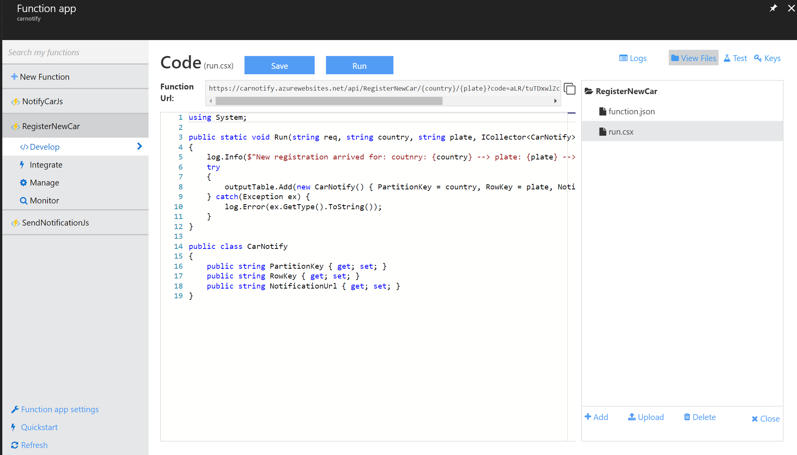
Function App Portal

Slide 9
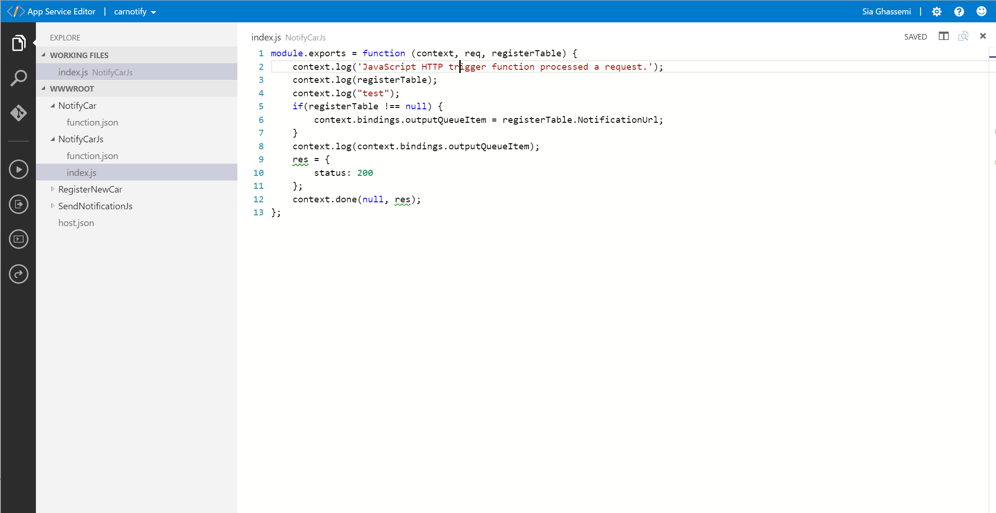
App Service Editor

Slide 10
Demo
Let‘s see some demo

